Slide 1

“GROCERY WEBSITE”
SRS

Slide 2
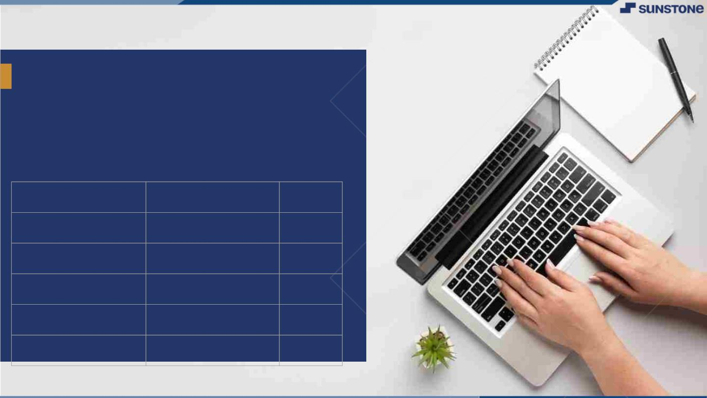
INTRODUCTION
The main goal for developing our project where customer can purchase the groceries based on the orders. Our project is very convenient for the customers.
The system decrease a much of work load for customer.
They can easily buy the grocery products from home through internet.
LMS Username
Name
Batch
PUGALENTHI. S
10
RABBANI MOHYADEEN.M
10
SASIKUMAR .R
10
THIYAGARAJAN .A
10
RATHISH .J
10

Slide 3

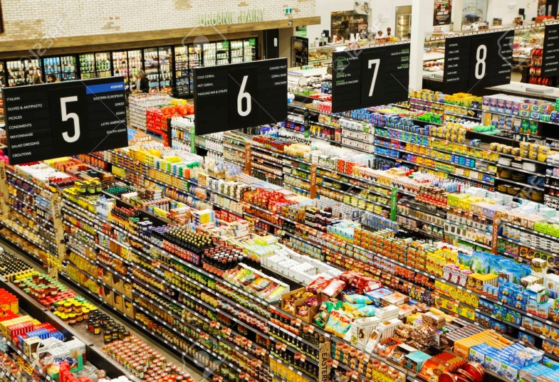
PURPOSE
The purpose of Grocery shop is it can saves time for customers. Customer can shop through online, Grocery shop are a destination for consumers who need to purchase food and household products for both everyday use and special occasions
Sell at lesser rate due to a lesser amount of overhead. Provide home delivery free of cost.
To ensure that the added or removed product is correctly displayed on the system

Slide 4
SOFTWARE REQUIREMENTS
Laptop or PC
Windows 10
Frontend : HTML, CSS & JavaScript
Visual Studio Code.
Backend : Java and MYSQL

Slide 5
HARDWARE REQUIREMENTS
Laptop or PC
Processor – Intel i3 based or higher
RAM – 4GB or higher
Hard Disk – 10GB or higher

Slide 6
FUNCTIONAL REQUIREMENTS
Functional requirements for developing an Grocery shop website can provide The system must send a confirmation email whenever an order is placed.
Functional requirements need to be clear and simple to use.
User Registration and Login
Product
Order
Payment
Admininstrator

Slide 7
NON FUNCTIONAL REQUIREMENTS
Non-functional requirements are requirements that are not directly concerned with the specific functions delivered by the system.
They may relate to emergent system properties such as reliable, response time for customers.
The non requirements mainly provide the performance, scalability, portability, compatibility, reliability, availability, maintainability, security, localization, and usability.

Slide 8
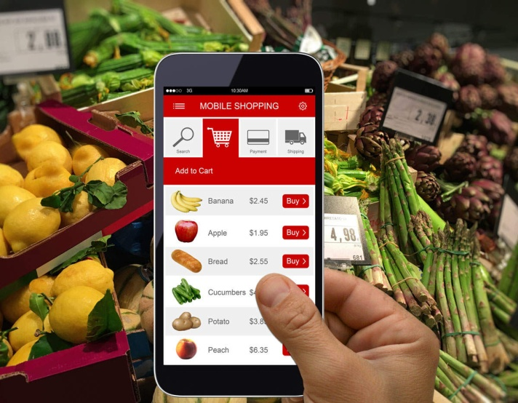
CONCLUSION
Our Project Grocery shop is very convenient for customer or users to buy online computer products. It can be observe that the information can be obtained easily and accurately.
The online grocery shopping website is made more user friendly to the users, so that anyone can run and access this website.
Grocery shop is a convenient way to purchase a variety of products.

Slide 9

AssessmentꢀParameter
Gatherꢀrequirementsꢀforꢀtheꢀ
project
addꢀReadme.mdꢀfileꢀwithꢀ
descriptionꢀofꢀtheꢀproject
Prepareꢀdatabaseꢀdesignꢀ
schemas
Check-List
Commitꢀallꢀchangesꢀwithꢀ"firstꢀ
commit"
Getꢀyourꢀinitialꢀprojectꢀ
Structureꢀready
createꢀaꢀrepositoryꢀonꢀgithubꢀ
realtedꢀtoꢀproject
Initiateꢀaꢀgitꢀrepository
Pushꢀyourꢀchangesꢀtoꢀgithub

Slide 10
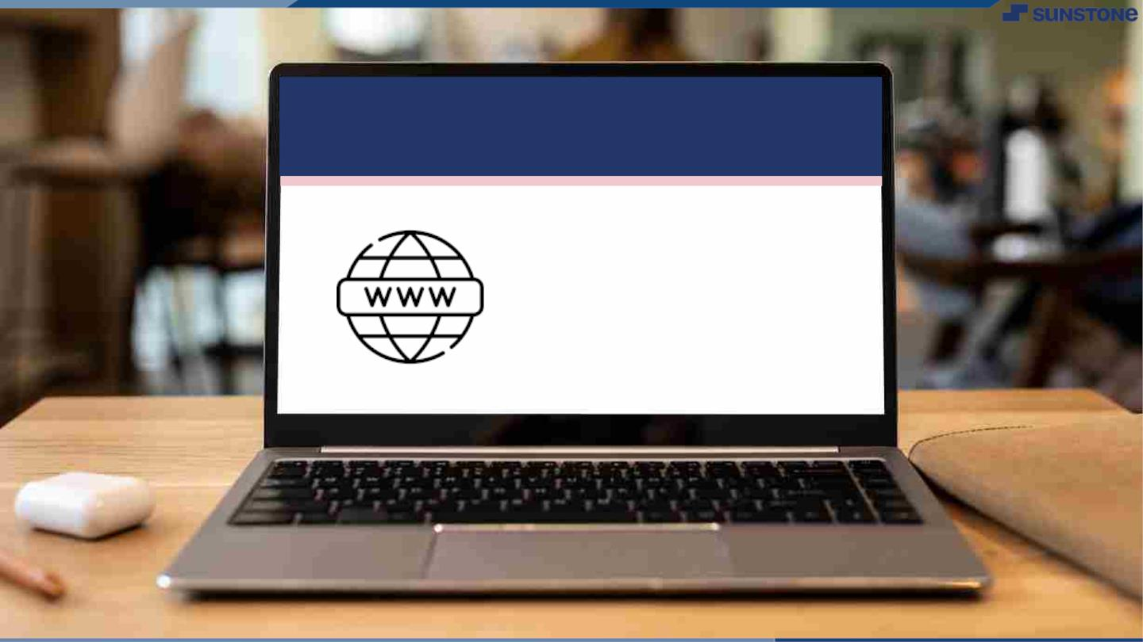
Submission Github
https://github.com/rishabh1723/NM-Batch10.git

Slide 11


